Slide 1
CogNet Project
Fall 2015
COSI 153a Mobile Application Development
Dimokritos Stamatakis
Xiaodong Qu
Namho An

Slide 2
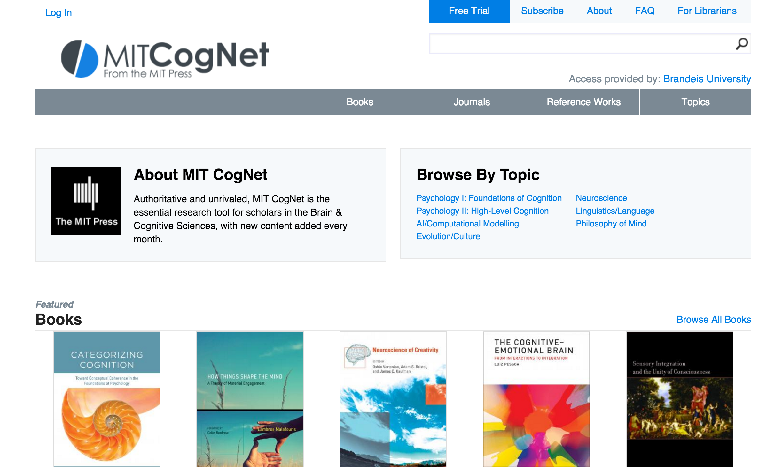
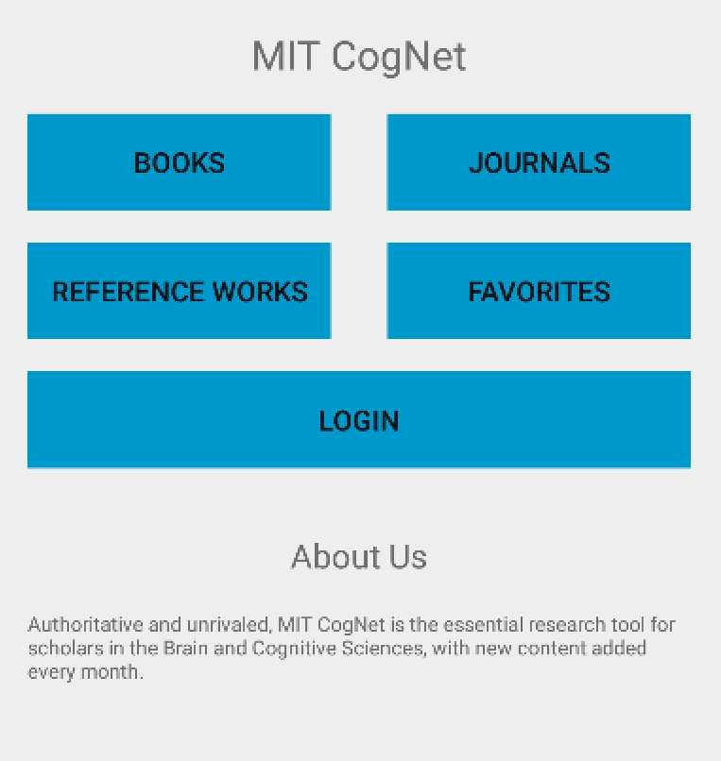
Project Introduction
Android App for cognet.mit.edu website
Development based on staging site – cognet-staging2.mit.edu
Secured data of books, journals and reference works
Website Ver. Android Ver.

Slide 3
What is MIT Cognet
Essential research tool for scholars in the Brain & Cognitive Science
Books, Journals, Reference Works
New content added every month
High Subscription costs for independent, but major institutions subscribed for students, e.g. Harvard, MIT, Stanford, UCLA, Tufts, Brandeis, Boston University etc.

Slide 4
Scope of Work
Login with username and password
Access control: only users with right permissions or from the right IP-range can access pdf files
Get content data from the website to the app using RSS feed, setting up RSS feed at the website, analyzing the XML data and display as ListView
Scroll down and search
‘Add-to-Favorite’ function, so users can bookmark their favorite books and journals

Slide 5
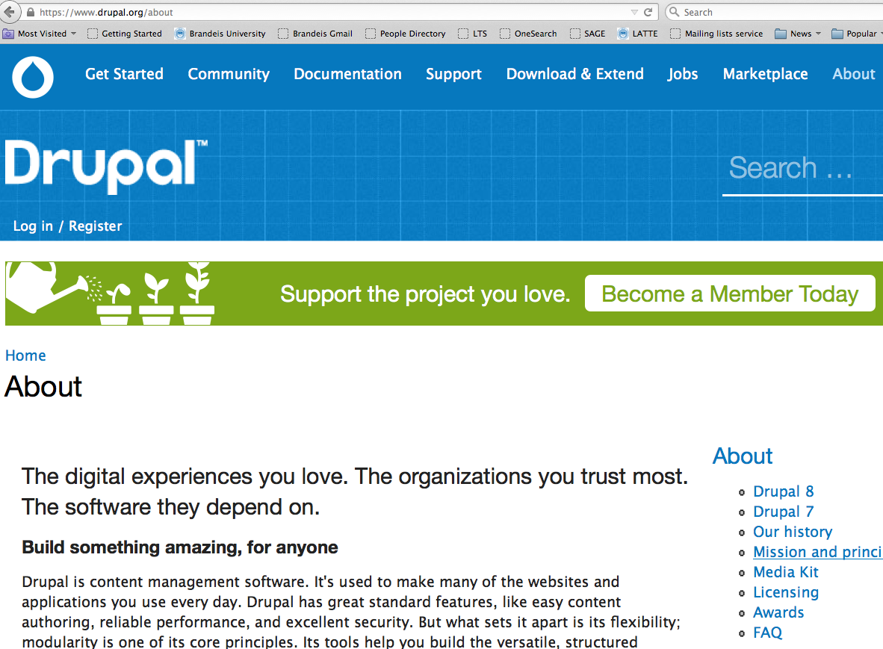
What is Drupal
Create and manage Web sites, free, open source, drupal.org

Slide 6
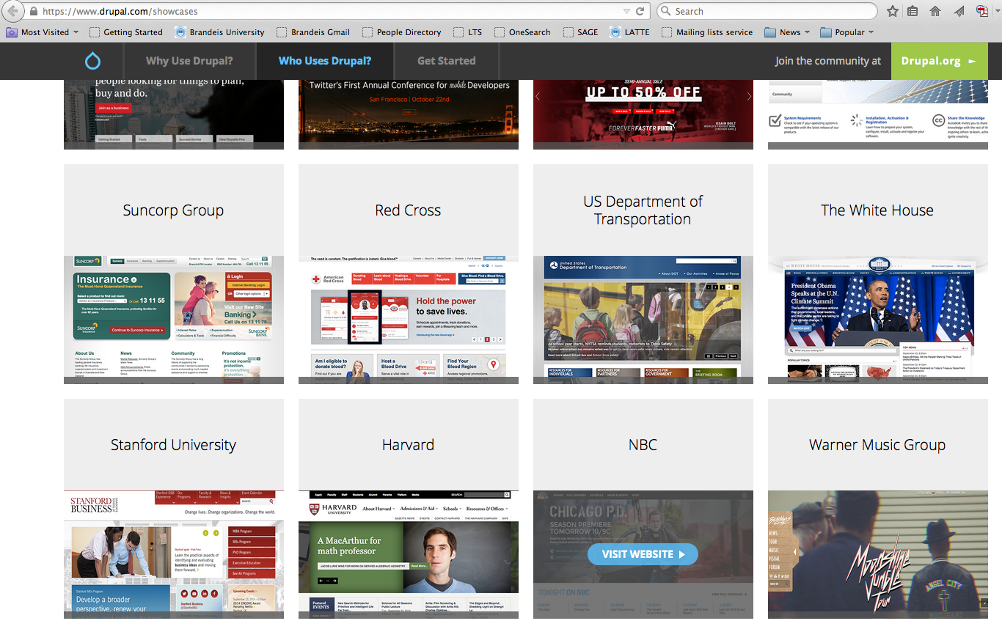
Who uses Drupal
Harvard, MIT, Stanford, Oxford, White House, NBC, BBC etc.

Slide 7
How we uses Drupal
Log in using username and password (users registered at CogNet website)
Access Secured content (PDF files) without login if within certain IP ranges (e.g Brandeis subscribed CogNet and whoever connected to Brandeis network has an access)
Using Feeds and views related modules to create RSS Feeds
REST API

Slide 8
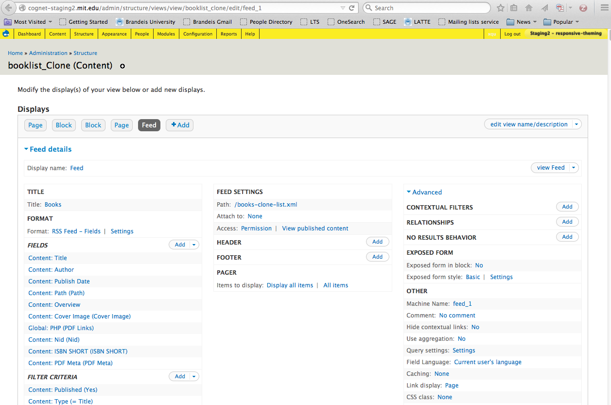
Create RSS Feed to get data

Slide 9
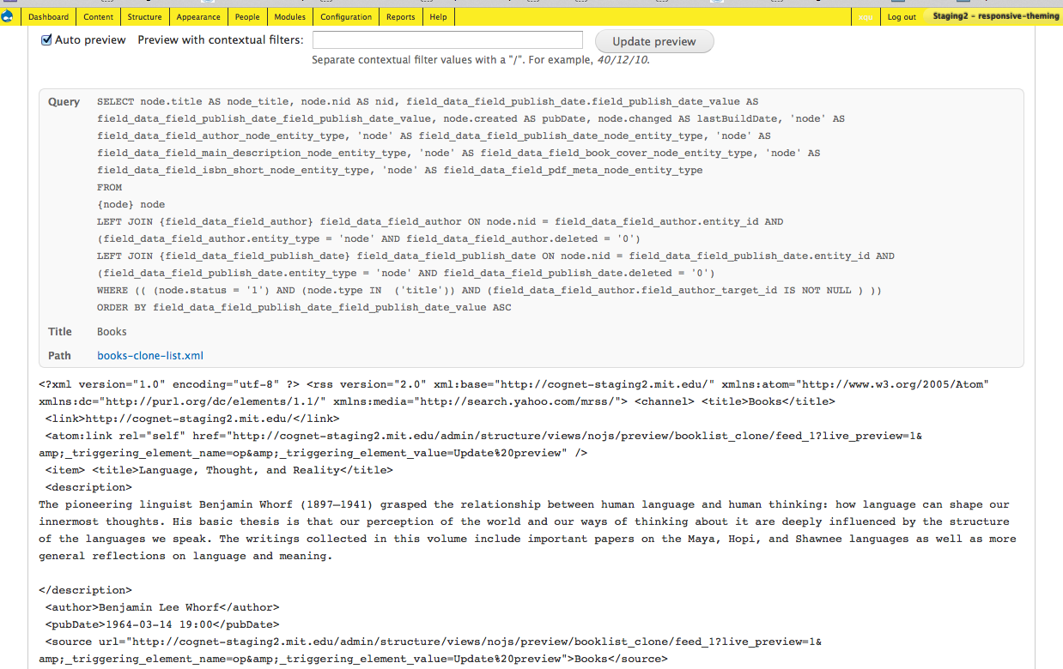
RSS example for Books

Slide 10
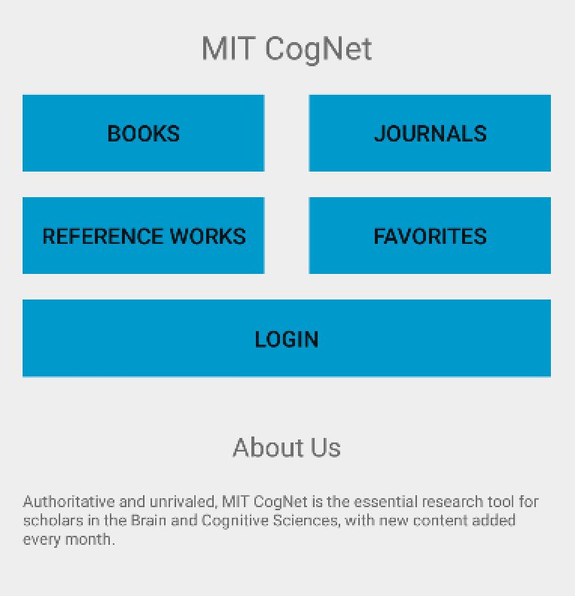
Home Page

Slide 11
Login
User can login to CogNet through the Login Activity
Add INTERNET permission in AndroidManifest.xml
Use REST API and apache HTTP client library
Representational State Transfer: HTTP requests
HTTP POST request to <server-ip>/rest/login
Should be done in a background thread!
Set HTTP headers for username and password
Analyzing server’s response
Successful login: cookie containing session ID
Unsuccessful login: message indicating there was an error
Store cookie and pass it to all child activities

Slide 12
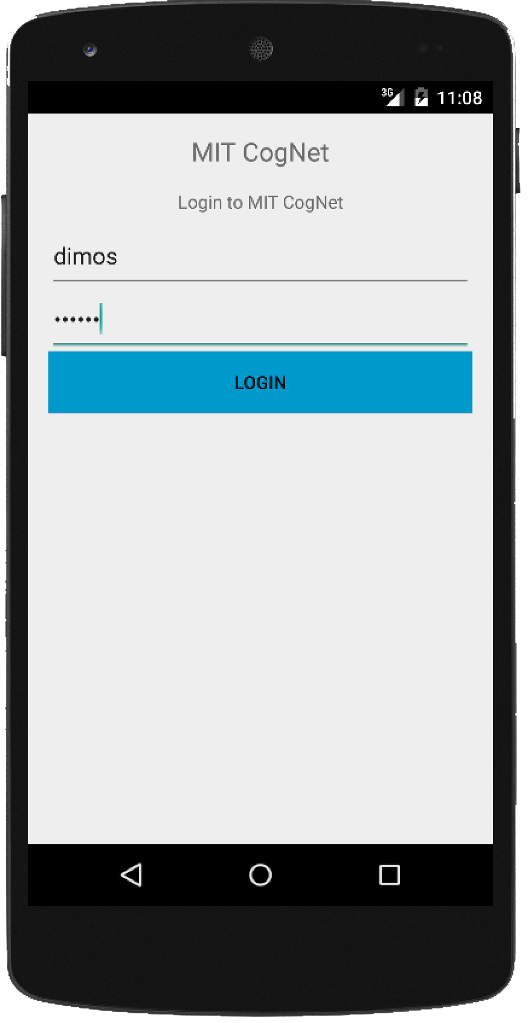


Login (cont.)
HTTP POST <cognet>/rest/login
Headers: username: dimos, pass: ****
Success! Take a Cookie
Keeping cookie in Main Activity

Slide 13
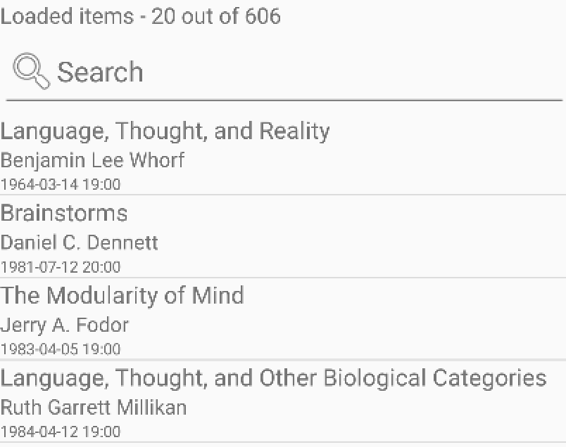
List of Items
Request to the CogNet Server
Items be Books, Journals, Reference Works, or Favorites
Retrieve specific items from RSS feed in XML format
Parse XML and Store Data in ArrayList
Use SimpleAdapter to bind the data to the ListView
Each item contains the title, author and publication date
Notes:
The arraylist contains hashmap and each hashmap contains those titile author pubdate, and simpleadapter binds the arraylist with the hashmap to the listview

Slide 14
List of Items: Scroll Event
Scroll Event (Endless ListView)
Initially, only 20 items are loaded
Scroll Event gets triggered when scroll reaches the bottom
loads the next 20 items
Presents the number of items loaded in the ListView
When the scroll reaches the bottom, it presents total number of items loaded

Slide 15
List of Items: Scroll Event (cont.)
We used AsyncTask for the scroll event
Background thread loads more items for the ListView
Makes a copy of the ArrayList with the items
Adds the new items to the copy, not the original
Event is raised to notify that background thread is done
Set the copy of the ArrayList as the new Adapter data
Notify the Adapter that data has changed
Exception is thrown if the background thread adds items in the original ArrayList
Notes:
Asyncronous is a request that does not block the one that is calling the request

Slide 16
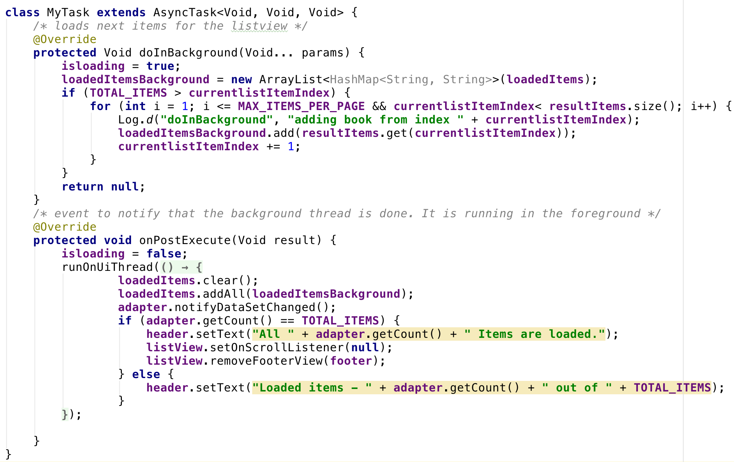
List of Items: Scroll Event (cont.)
Notes:
AsyncTask class, it implements two method. Doinbackground and onpostexecute. In DIB, runs backgrounds thread. In this background thread it adds the new items to the copy of the arraylist.( loadeditemsbackground). In onpostevecute is when the background thread is done. It is executed in the foreground.It notify the adapter that the dataset has changed. (adapter.notifyDataSetchanged). It sets the text of the header according to the number of loaded items. For example all ~~ items are loaded or Load\ed items ~~ out of total

Slide 17
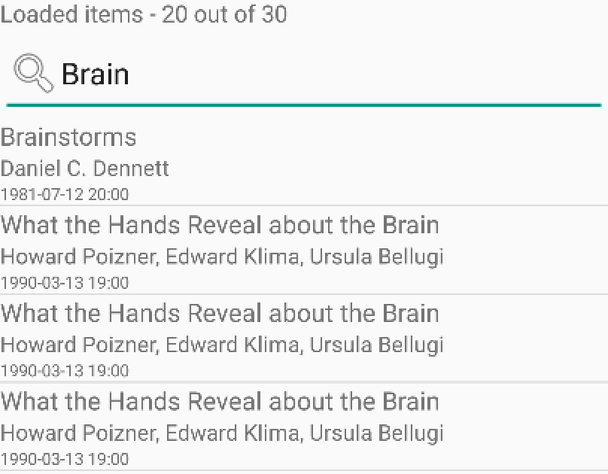
Searching Function
In the search field, event when the text changes
Generate result list to contain the matches
Used AsyncTask to add items that match the search
Update adapter
Maintain index in the data ArrayList

Slide 18
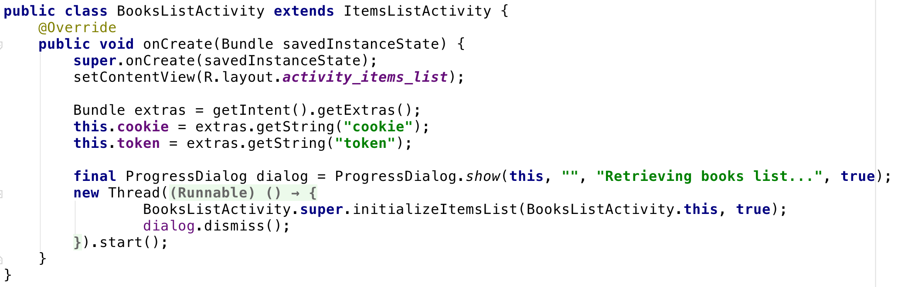
Java Inheritance
ItemsListActivity is the super class of all item categories
books, journals, etc.
Each List Activity category extends the ItemsListActivity
BooksListActivity, JournalsListActivity, etc.
Inherits common functionality
Calls super.initializeItemsList() and passes parameter itself

Slide 19

Description Page
Description Activity is started when a list item is selected
Encapsulated in the Intent: Information of the selected item
Title, author, publication date, description, ISBN, etc.
Images are retrieved from Server with HttpURLConnection
Notes:
When one of the items is selected we start a description activity for this item. We pass as an intent information about this item such as title, author a…..
We request the images from the server HTTPURLconnection by using the url contained in the intent

Slide 20
Viewing PDF
Only have access when you log in or within subscribed institution’s network
Brandeis is subscribed in CogNet, no need for login!
RSS feed contains the ISBN of the book
From ISBN we can get the link of the PDF
Include the cookie if not in a subscribed network

Slide 21
Viewing PDF (cont.)
Attempted to use WebView and the Google docs plugin
Initial HTTP request will be sent to the Google docs server
Google docs server will forward the request to CogNet
https://docs.google.com/gview?embedded=true&url=cognet.pdf
Problem: Google server does not forward the cookie to the CogNet server
The request cannot be authenticated
Next approach:
Download pdf in the device
Start a new Intent for viewing PDF
Action: Intent.ACTION_VIEW
Data and Type: pdf_URL, “application/pdf”

Slide 22
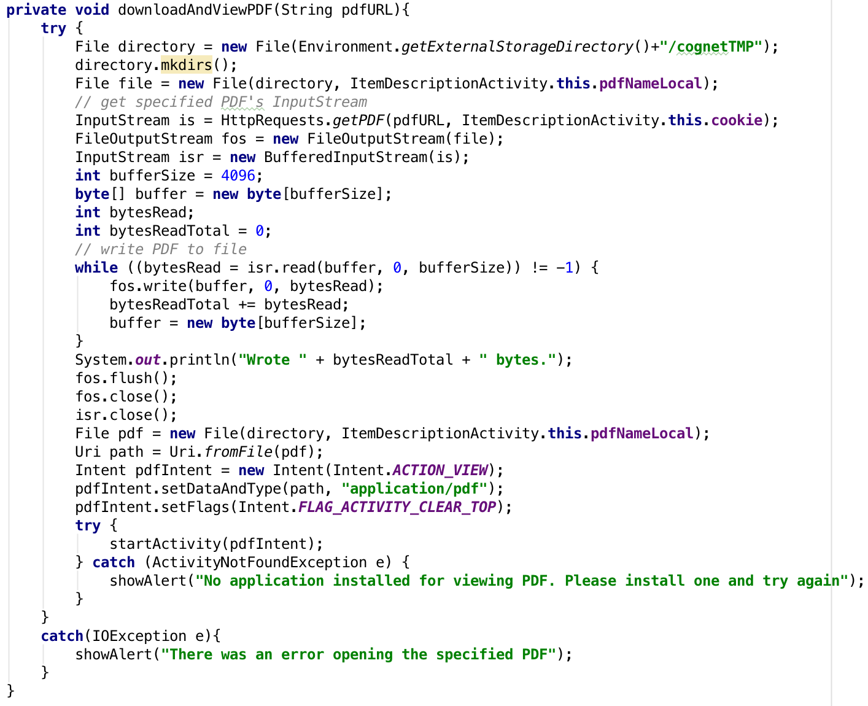
Viewing PDF (cont.)

Slide 23
“Add-to-Favorites” function
Selected items are added in a list and stored in SQLite Database
“add favorite” button becomes “delete favorite” if item exists in favorites
Another ListView which gets items from the SQLite Database
FavoritesListActivity extends ItemsListActivity
Supports scroll event and search

Slide 24
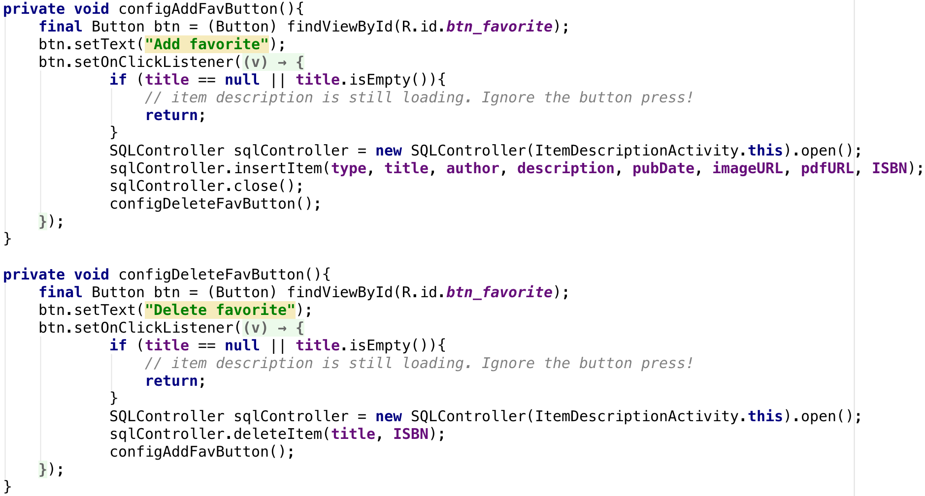
“Add-to-Favorites” function

Slide 25
Thank you!
Please feel free to browse CogNet:
http://cognet.mit.edu
Let us know if you have any questions!

